Slide 1

RDS Read-Replicas
7/24/2023

Slide 2
Read-Replicas
Why use them?
Improved read performance
Scalability
High Availability
Disaster Recovery
Cost-effective
Compartmentalized Load
Compliance

Slide 3
AWS Supported Replication
Traditional RDS
Native support for MySQL, MariaDB, PostgreSQL, SQL Server AWS RDS Instances
Aurora RDS
Native support for MySQL, PostgreSQL

Slide 4
Selective Replication
Cost Savings
Less storage replicated
Less data transfer (if cross region)
Better Performance
Less writes means less performance
Improved Security
By replicating only the data that is required, you can limit the exposure of sensitive data to unauthorized users.

Slide 5
Deployment pre-reqs
Source RDS instance
Optional: Security group for SG allowed rules
Sufficient storage resources
Matching engine versions (major and minor)
Optional, but recommended replica configuration
Matching PG
Matching OG
Same storage type (more on this later)
Same replication parameters (more on this later)
Same TZ parameter

Slide 6

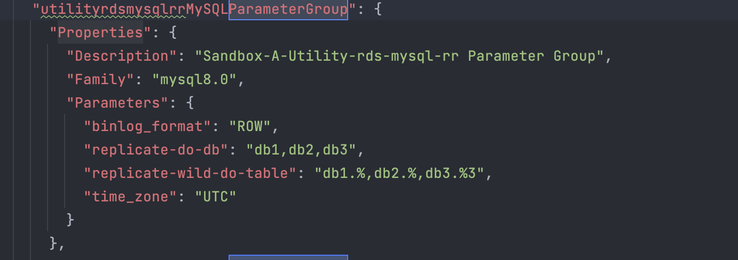

Replication PG Configuration
Deployment Time 10-40 min
Pre-deployed instances have the following PG settings:

Slide 7
IaC CloudFormation Deployment
Parameter Group Config

Slide 8
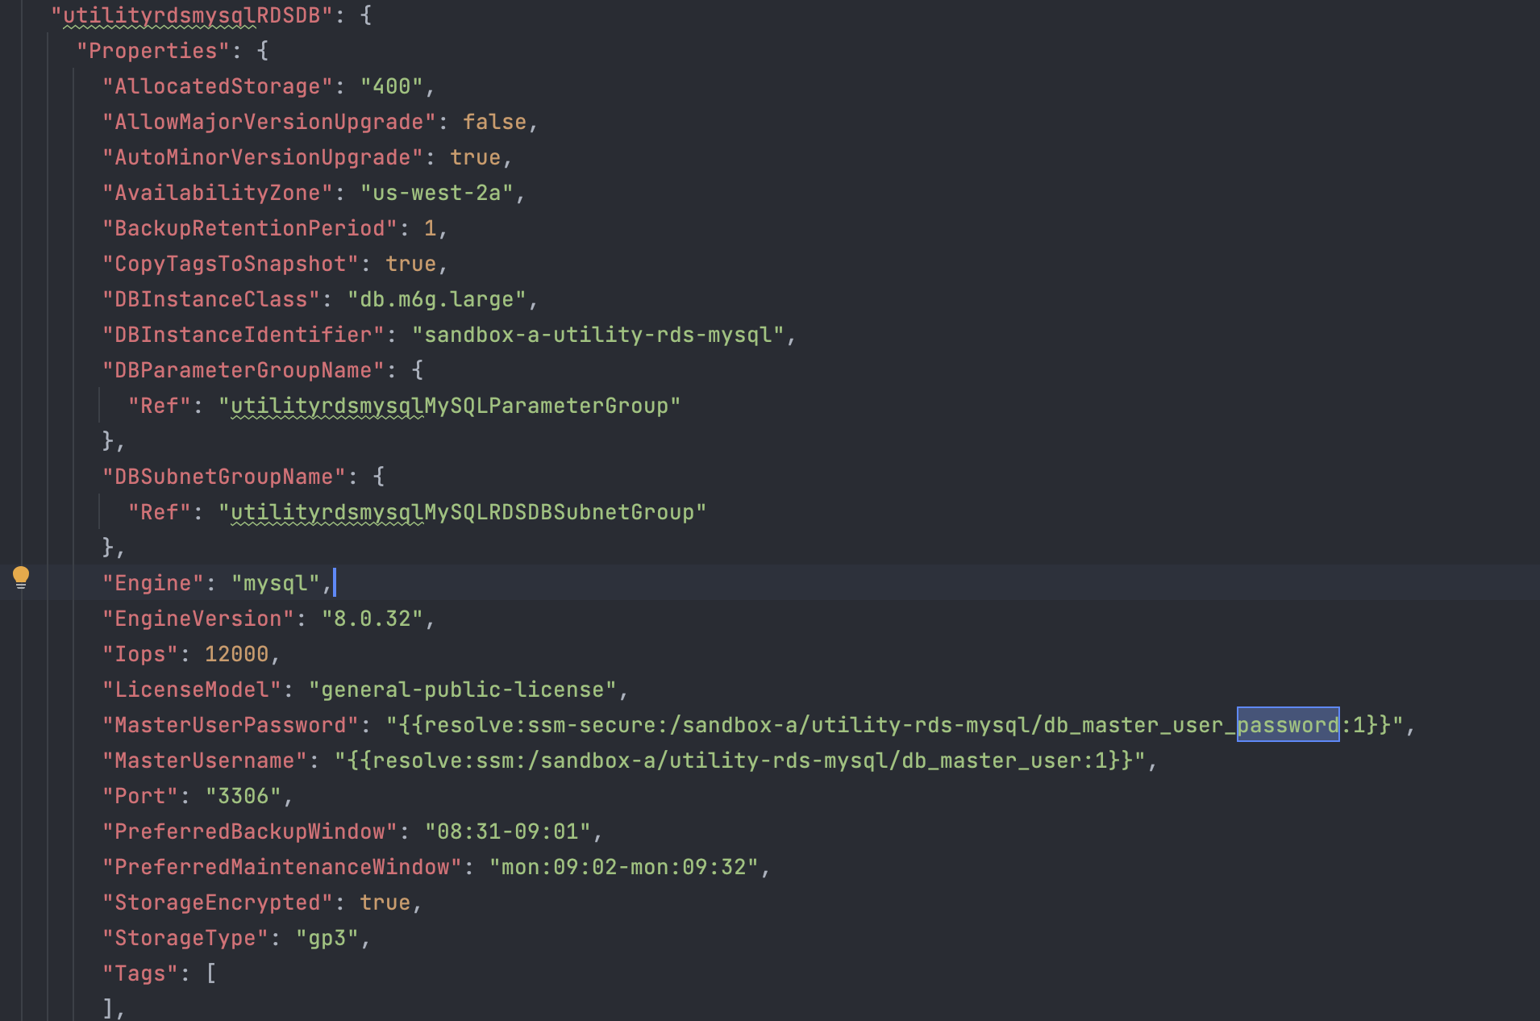
Read-Write RDS Instance Code

Slide 9
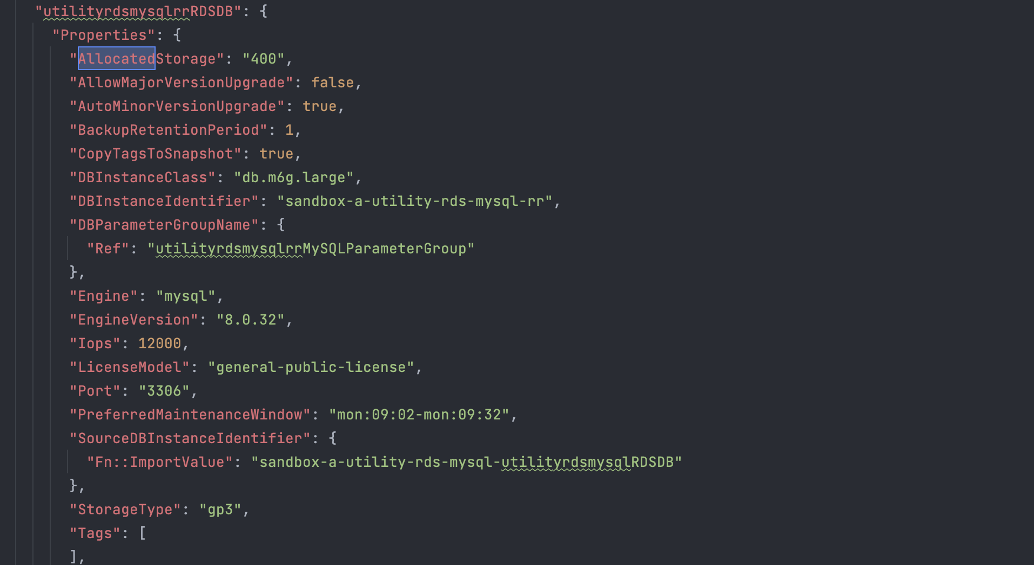
Read-Replica RDS Instance Code

Slide 10
RR Deployment process
A snapshot of the source instance is taken to create the RR.
The new RR instance is created from that snapshot
The original parameter group is applied, as it was attached to the snapshot the RR was created from.
The original option group is applied, as it was attached to the snapshot the RR was created from.
The storage type is converted and must go through a "storage optimization phase". While in this phase, the source instance parameters and options are still applied. After storage is complete:
Then the RR option group is applied
Then the RR parameter group is applied.

Slide 11
Validating Replication
SHOW slave status \G;
SHOW replica status \G;

Slide 12
Replication Error Setup
Add db4table1
1
Not replicated due to Parameter Group
Validate RR is not receiving replication
2
Add to db4 with replication - demonstrate table in instance
3
Observe no table
Add row to db4table1
4
Expected Error

Slide 13
Replication Errors
Identify Replication Errors: The first step in identifying replication errors is to check the replication status in the AWS RDS console. The console will display the replication status for each read replica, including any error messages or alerts. You can also use CloudWatch logs to view detailed replication logs, which can help you identify specific errors.
Troubleshoot the Error: Once you have identified the replication error, you should troubleshoot the issue to determine the root cause. Depending on the error message, this may involve checking the primary database configuration, checking network connectivity, or verifying the replication settings.
Skip the Error: If you have identified the replication error and determined that it can be safely skipped, you can use the AWS RDS console to skip the error and re-enable replication. To do this, navigate to the "Replication" tab for the affected read replica and select "Modify" to edit the replication settings. Then, select "Skip" for the specific error that you want to ignore and save the changes.
Verify Replication: After skipping the error and re-enabling replication, you should verify that replication is working correctly. Check the replication status in the AWS RDS console and monitor the CloudWatch logs to ensure that there are no further errors or issues. You may also want to run some test queries to verify that the read replica is replicating data correctly.

Slide 14
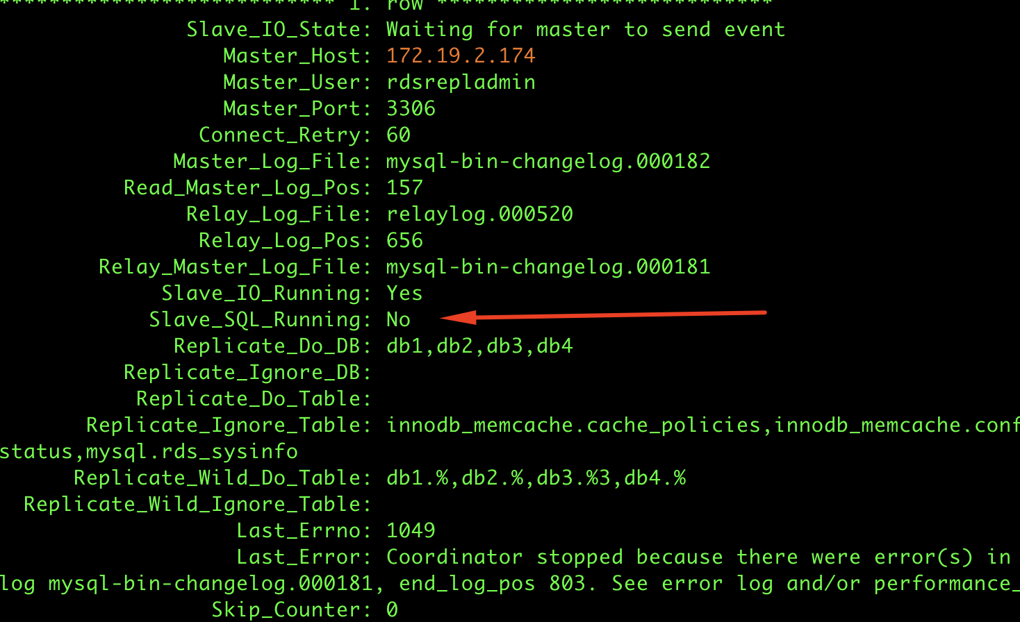
Replication Errored/Stopped

Slide 15
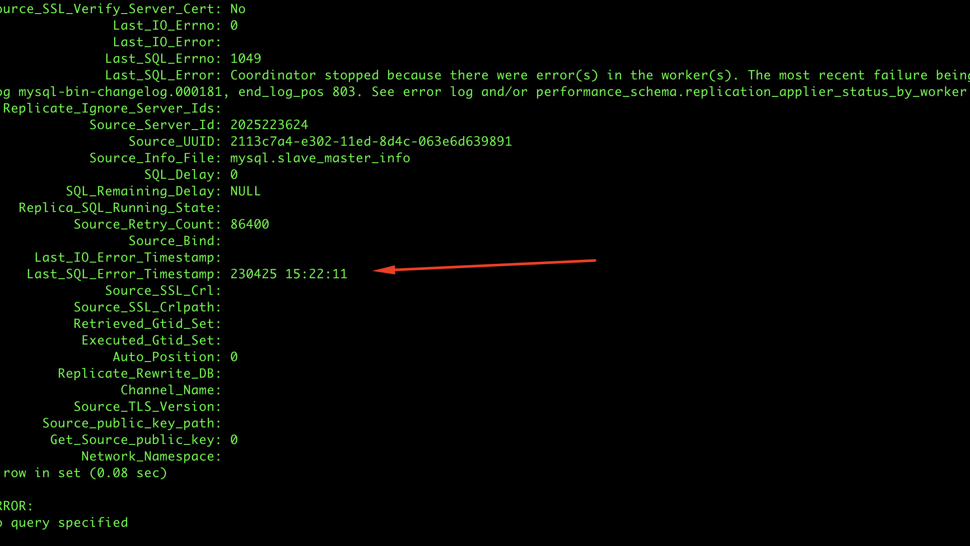
Error Info

Slide 16
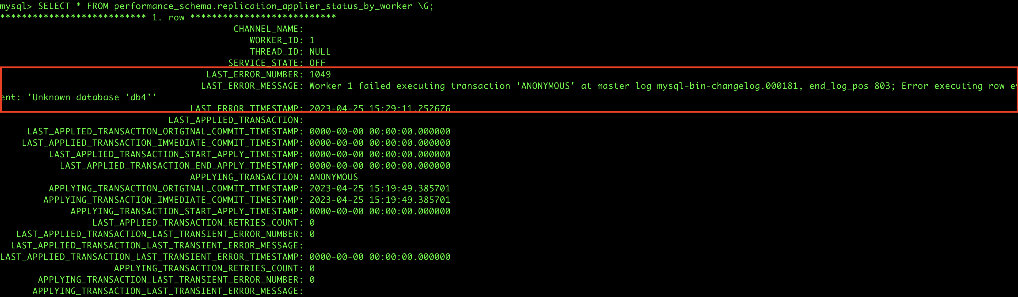
Locating Error Messages
SELECT *
FROM performance_schema.replication_applier_status_by_worker \G;

Slide 17
Clearing replication error
Identify/Read error message
1
Drop table in source
Recreate table in source
Reinsert row
NOTE: This can result in loss of data if improperly performed
Skip error messages after reviewing
2
Clear message to restart replication:
3
CALL mysql.rds_skip_repl_error;

Slide 18
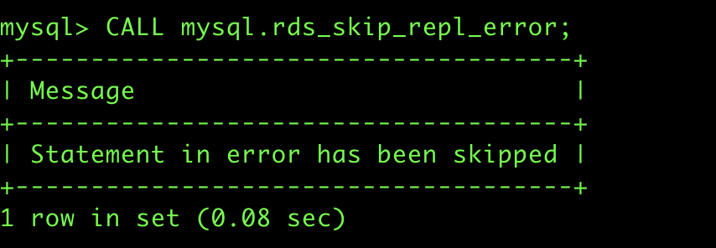
Skipping Error(s)

Slide 19
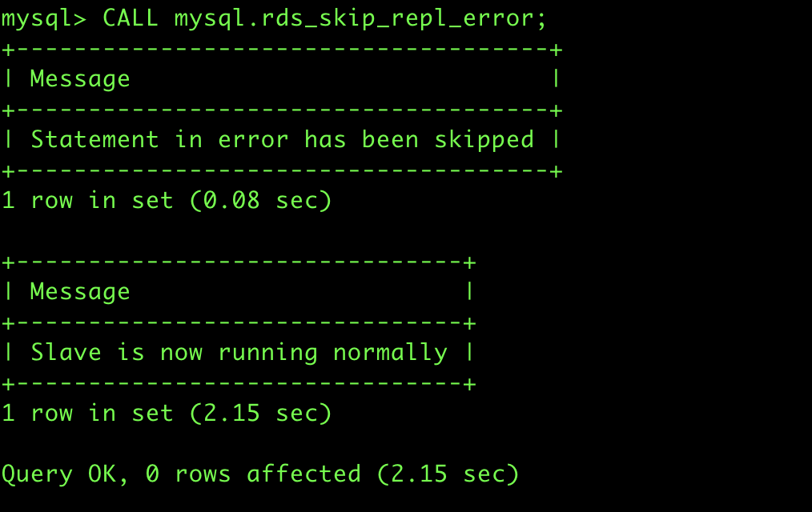
Cleared error

Slide 20
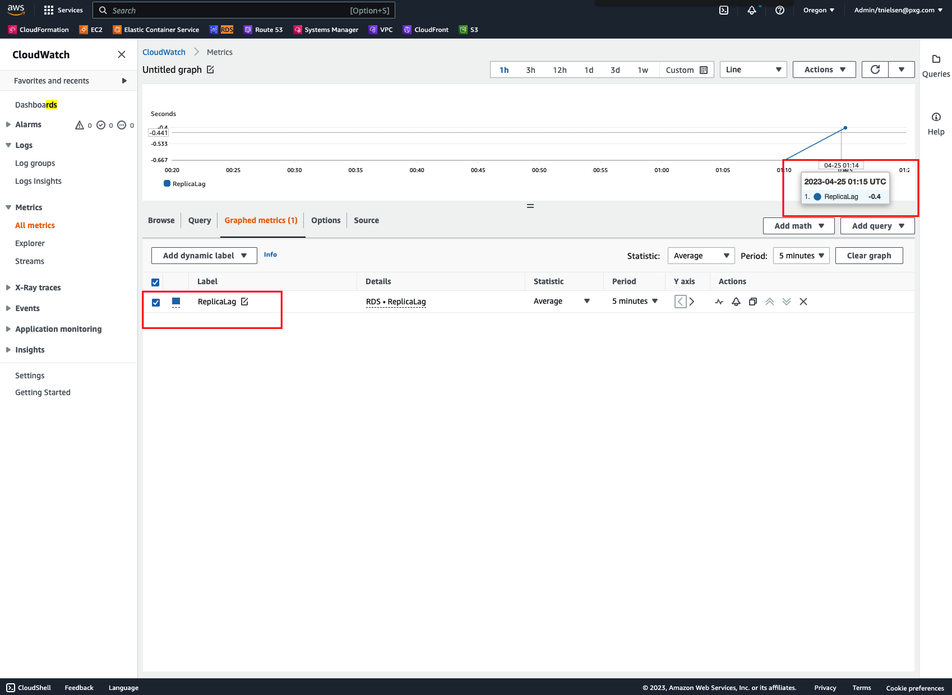
Monitoring
CloudWatch alerts have a metric for binlog latency named “ReplicaLag”
Use CloudWatch Alarms/Notification
Use your fave observability platform instead (Datadog)

Slide 21
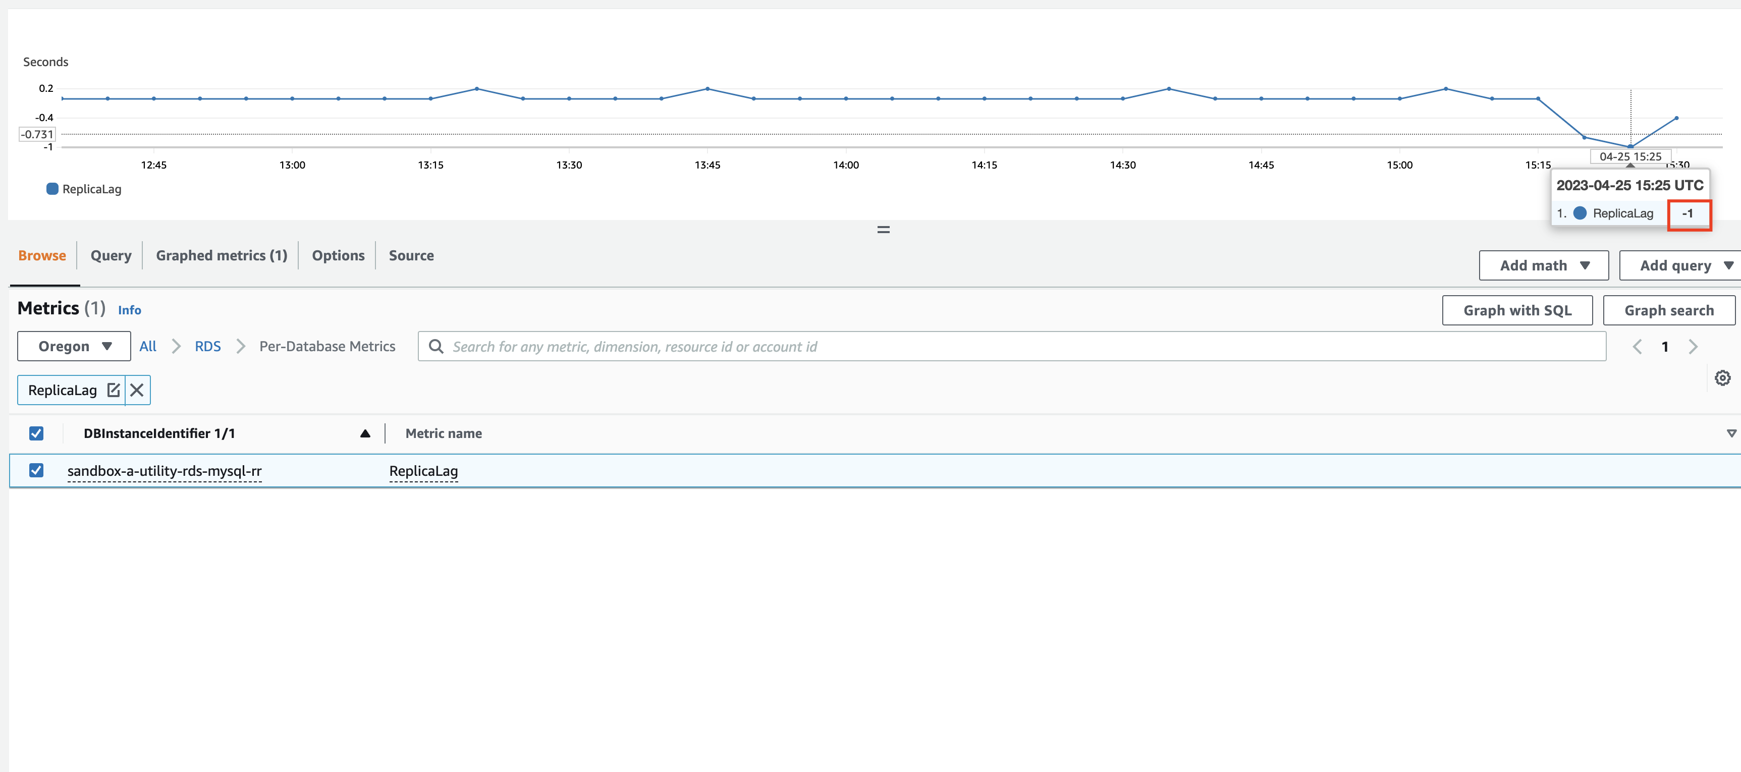
Monitoring
-1 Indicates “off”

Slide 22
Promoting a Read-Replica to Read-Write Instance
DR Scenarios
Failure Scenarios
Note: Not CFN supported
aws rds promote-read-replica \ --db-instance-identifier sandbox-a-utility-rds-mysql-rr

Slide 23
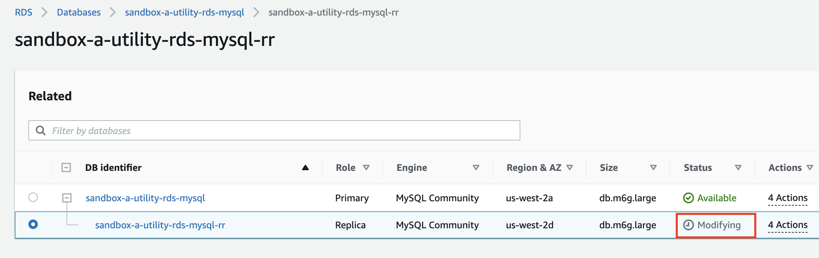
Read-Replica Promotion

Slide 24
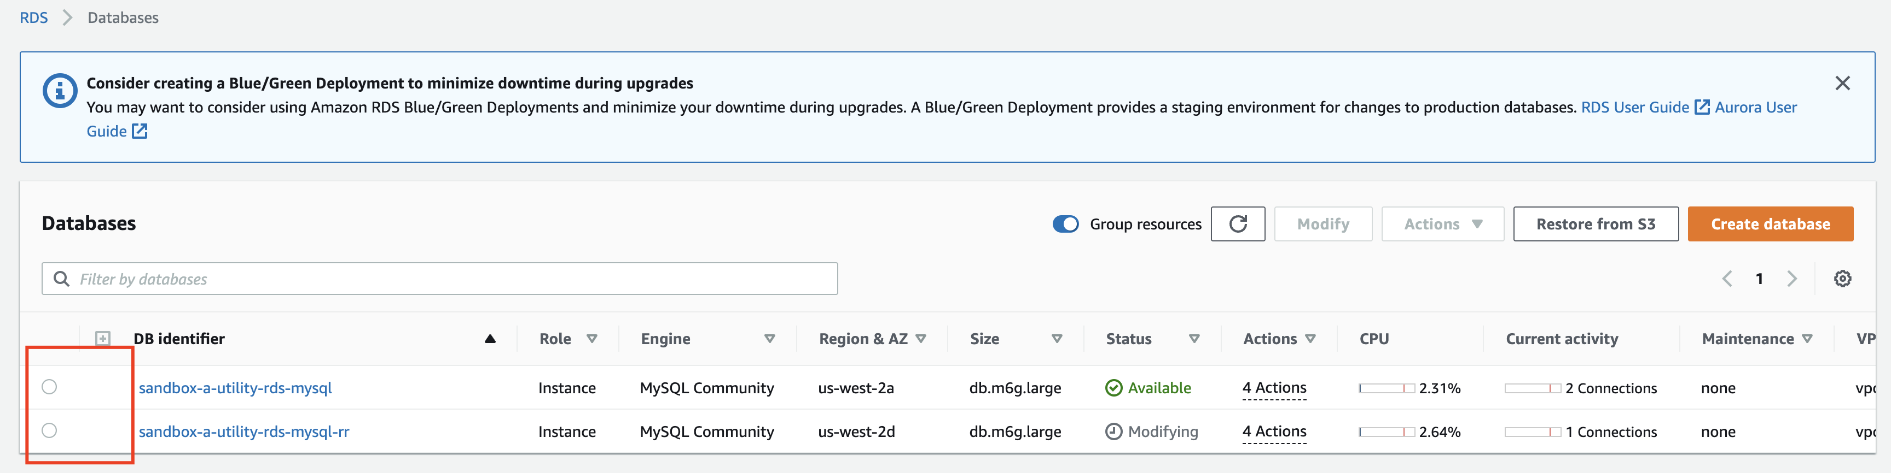
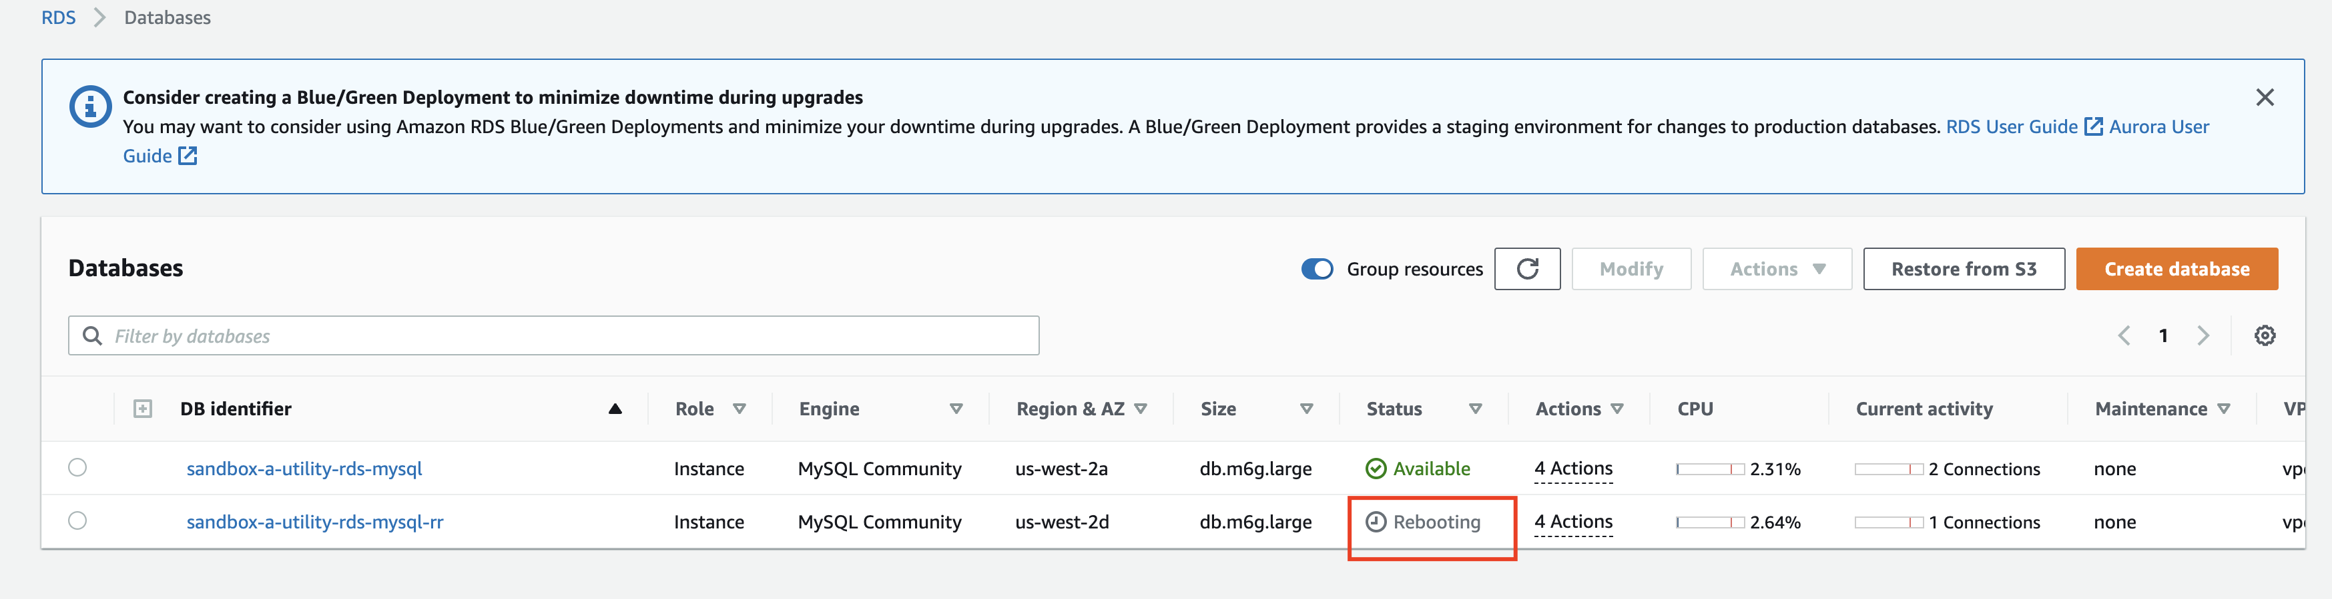
Read-Replica Promotion

Slide 25
Failing Back
Redeploy old primary stack AS RR
Sync data as read-replica
Promote
Redeploy RR stack

